Slide 1

Non-invasive point of care ECG signal detection and analytics for cardiac diseases
Bachelor of Technology
for the course
CL 499
Presented By
Shubham Kumar Gupta
Roll No. 180107058
Under supervision of
Professor Resmi Suresh
Professor Dipankar Bandyopadhyay

Slide 2
Content
Objective
Electrocardiogram (ECG)
Working Principle of ECG
Case Study
Circuit & Block Diagram
Micropatterned Conductive Surface
Dataset Refining
Dataset Modelling
Results and Discussion
Conclusions
Future Scopes
References

Slide 3
Objective
Acquire information about the ECG and its working
Analyze different product in the market (like Apple's ECG watch and Sanket's 12 Lead ECG), and to analyze what limitations, constraints and issues remain and how we may come up with a better solution with some enhancement.
Work on sample dataset, predict variety of diseases related to the heart especially Atrial Fibrillation
Develop our portable, noninvasive point-of-care system for monitoring ECG levels using micropatterned electrode like “Electrically conductive Silicone Rubber Sheet” or “Conductive Hook & Loop System
Collection of our own datasets and improvement of the model.
Cloud analysis of ECG recorded data using exported model file over Heroku test deployment.

Slide 4
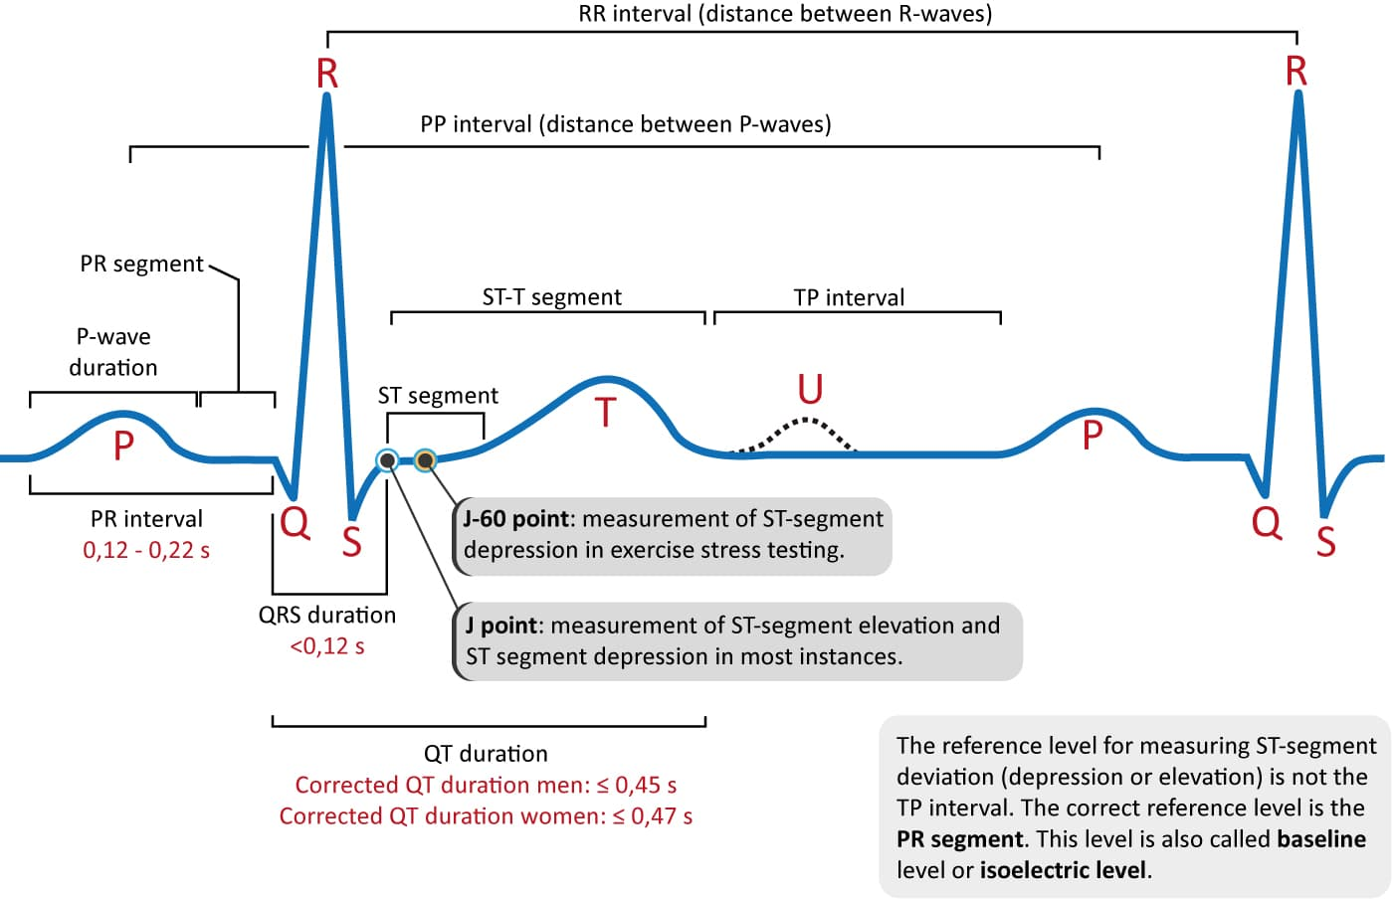
Electrocardiogram (ECG)
Electrocardiogram records electrical signals in heart in SA node present in right atrium due the ions concentration gradients.
Using electrodes, ECG records heart's electrical activity by putting electrodes at various points on the body.
Electrocardiogram can be used to detect:
Abnormal heart rhythm (arrhythmias)
If blocked or narrowed arteries
Proper check on working of pacemaker
ECG is plotted on a graph paper in which 1mmx1mm square box corresponds to 0.04s on the x-axis and 0.1mV on the y-axis
Out of 12 ECG leads we have 6 limb leads and 6 chest leads using 10 electrodes as some are bipolar like augmented leads
ECG waves and intervals are classified as P-wave, PR interval, QRS Complex, J-wave, ST segment, T-wave, and U-wave
Figure 1 Morphology of an ECG wave; Source: Design of Model Free Sliding Mode Controller based on BBO Algorithm for Heart Rate Pacemaker. International Journal of Modern Education; Description: This figure shows the labeling of the different sections of an ECG wave

Slide 5
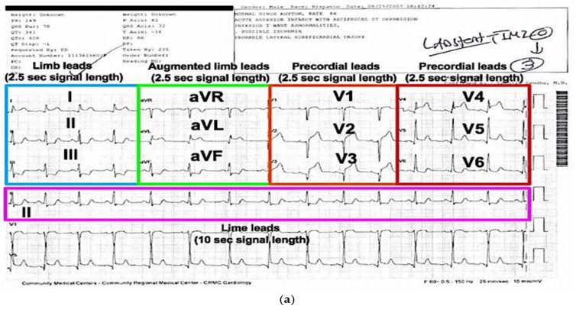
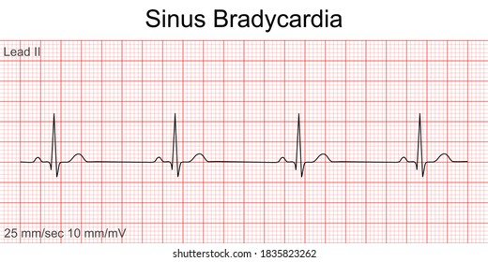
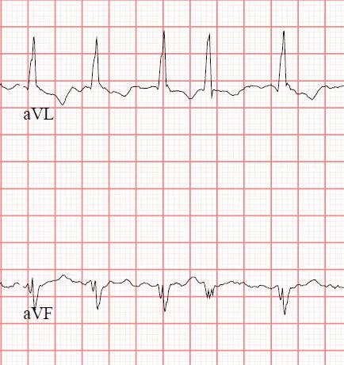
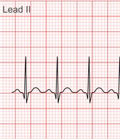
Electrocardiogram (ECG)
Tachycardia
excessively rapid
Atrial Fibrillation
Irritable, irregular,
blocked signals
Source: heart.org
Description: Here, figure 2 shows the recorded ECG waves of an abnormal heart
Figure 2 Sample Recorded Electrocardiogram; Source: ECGlibrary.com; Description: This figure shows the recorded electrogram of a person; here, it shows different sections of the recorded leads.
Bradycardia
sluggish

Slide 6
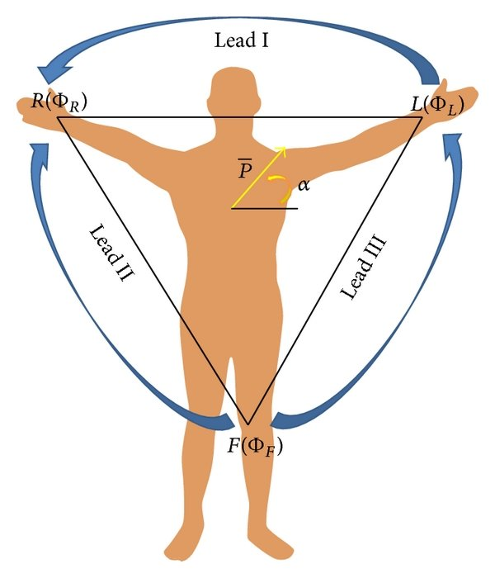
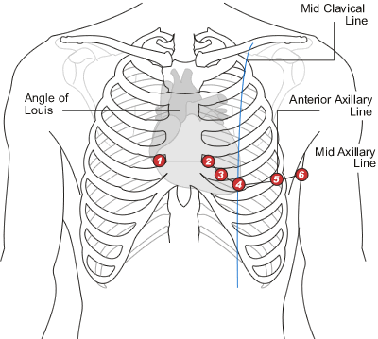
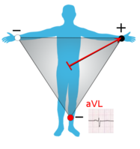
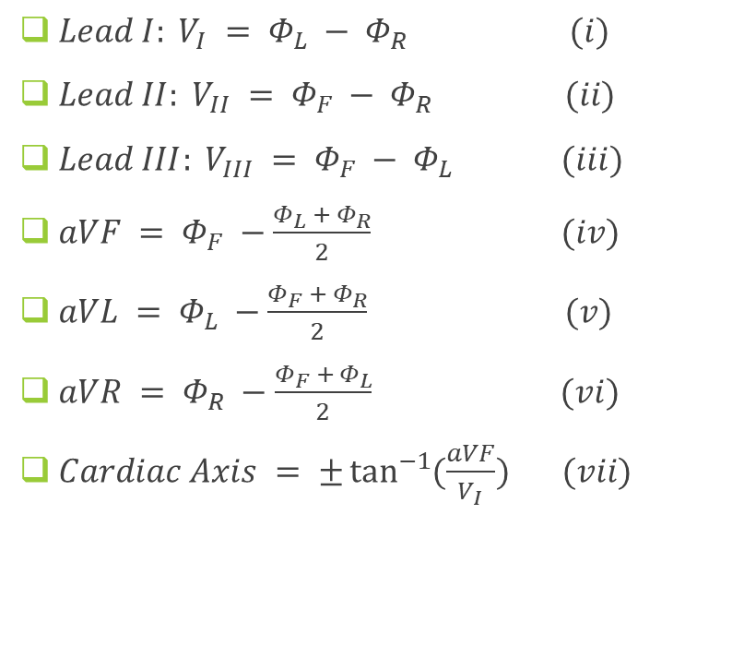
Working Principle
$Lead I: V_{I} = Φ_{L} − Φ_{R} (i)$
$Lead II: V_{II} = Φ_{F} − Φ_{R} (ii)$
$Lead III: V_{III} = Φ_{F} − Φ_{L} (iii)$
$aVF = Φ_{F} −\frac{Φ_{L} + Φ_{R}}{2}$ $(iv)$
$aVL = Φ_{L} −\frac{Φ_{F} + Φ_{R}}{2}$ $(v)$
$aVR = Φ_{R} −\frac{Φ_{F} + Φ_{L}}{2}$ $(vi)$
$Cardiac Axis = ±\tan^{−1}{(\frac{aVF}{V_{I}})} (vii)$
Figure 3 ECG Leads; Source: Camm, A. J., Lüscher, T. F., Maurer, G., & Serruys, P. W. (Reds.). (2018). ESC CardioMed; Description: This figure shows the labeled diagram of the chest showing six chest leads position and 4 limb leads

Slide 7
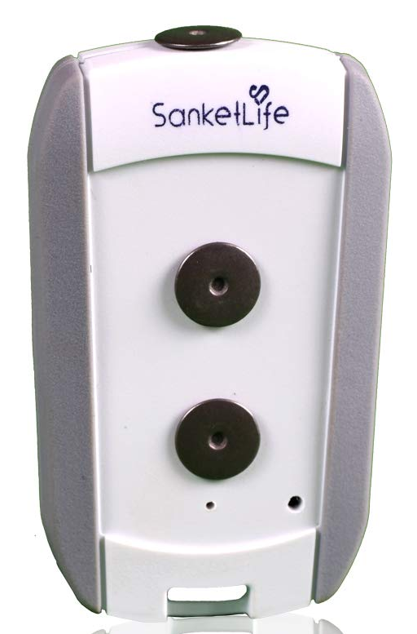
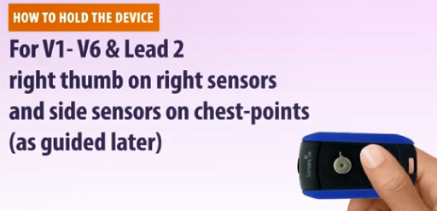
Case Study (Sanket’s 12 Lead ECG)
Pros
Sanket's ECG is small portable ECG device that is widely used in rural markets.
No need for additional wired electrode placements.
Cheap compared to other devices (3k INR)
Can record 12 Lead ECG signal
Has total of 3 electrode contact point system, which are touched at different body parts to get a single lead ECG
Completing different circuits we can get all 12 Leads ECG using it
Cons
Not cheap if we are targeting rural areas
Needs assistance of a medical practitioner to use it
Sweat, loose grip may tamper the results
Misplacement of electrode may result in improper results
Better noise deduction can be obtained
Not enough information as output
Figure 4 Sanket's 12 leads ECG, Source: mashelkarfoundation.org, Description: This figure shows this sanket's ECG device

Slide 8
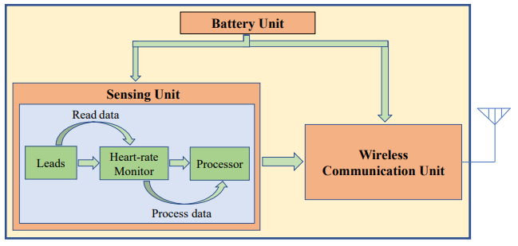
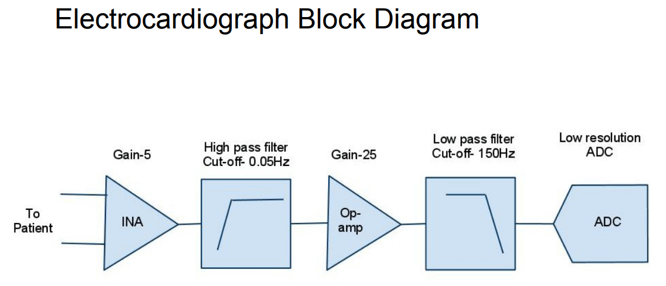
Circuit & Block Diagram
Contain total of three units:
Battery Unit (Power Source)
Sensing Unit
Wireless Communication Unit
Sensing Unit
Capture leads
Monitor heart rate
Process them like passing wave via various electrical circuits like amplifier or band pass filters, and denoising the final output signal
Then Analog signals are converted to digital signals and sent to Wireless Unit
Wireless Communication Unit
Output data generated from sensing unit should be transferred to mobile application using the wireless may be wifi/Bluetooth/internet cloud channels
Figure 5 Block Diagram of an ECG device, Source: Design and Implementation of Long-Term Single-Lead ECG Monitor. Journal of Biosciences and Medicines; Description: This figure shows the block diagram of an ECG device showing how the data is processed from analog to digital

Slide 9
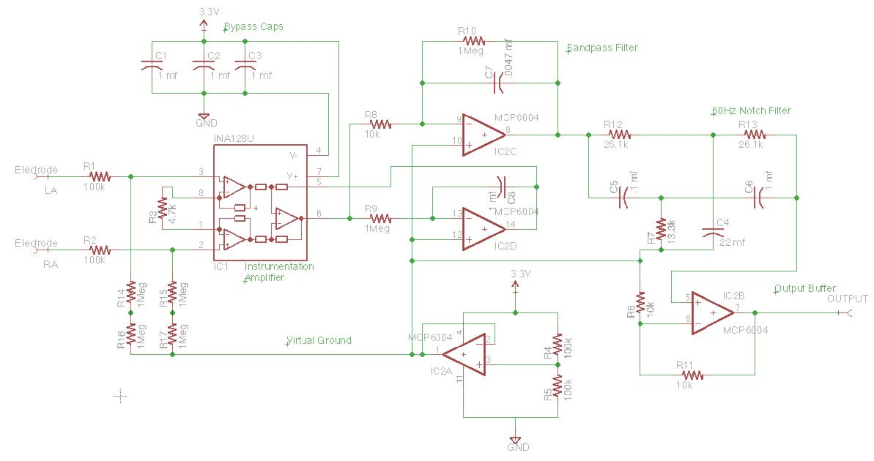
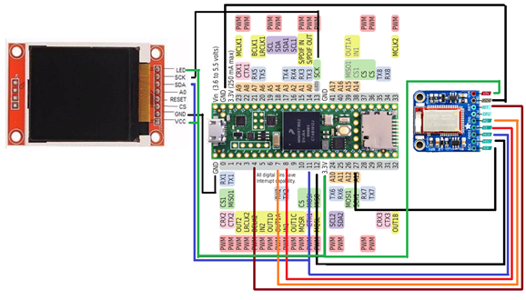
Circuit & Block Diagram
Circuit Diagram
Source: CSE 474 courses.cs.washington.edu
Circuit Diagram

Slide 10
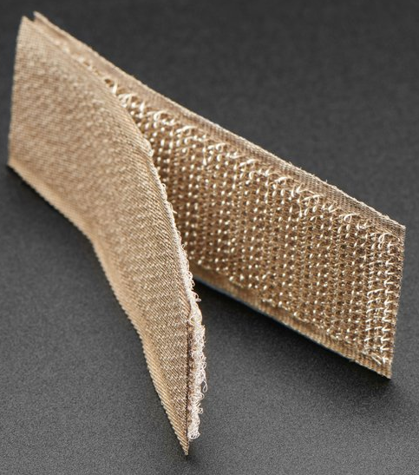

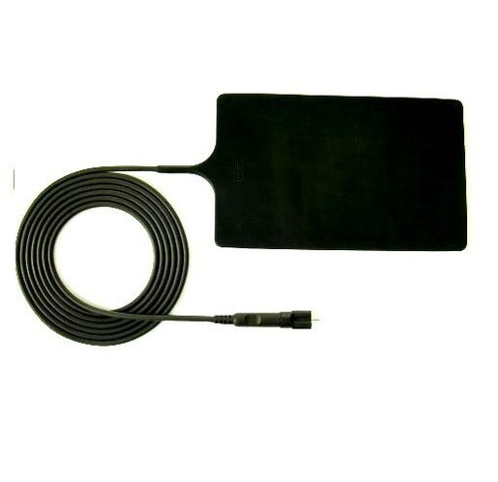



Micropatterned Conductive Surface
Electrode Materials |  | Components | Structure | Fabric Thickness (mm) | Yarn Diameter (mm) | Wales/cm | Courses/cm
TE1 |  | 78% silver plated nylon 66 + 22% Elastomer | Weft knitted | 0.45 ± 10% | 0.13 ± 20% | 28/cm | 30/cm
TE2 |  | 100% silver plated nylon 66 | Weft knitted | 1.25 ± 10% | 0.60 ± 20% | 5/cm | 6/cm
TE3 |  | 100% silver plated nylon 66 | Weft knitted | 0.70 ± 10% | 0.30 ± 20% | 8/cm | 12/cm
TE4 |  | 94% silver plated nylon 66 + 6% elastomer | Weft knitted 3D spacer | 2.50 ± 10% | 0.18 ± 20% | 17/cm | 28/cm
 |  |  |  |  |  | (surface) | (surface)
Conductive Hook & Loop
Resistivity: 1.4 Ohm per sq inch
Electrically conductive Silicone Rubber Sheet
Resistivity: 1.57 to 3.14 Ohm per sq inch
Avg : 2.35 Ohm per sq inch
A Hybrid Textile Electrode for Electrocardiogram (ECG) Measurement and Motion Tracking (nih.gov)
Conductive Hook & Loop Tape - 3" long - Thingbits Electronics
Electrically Conductive Silicone Rubber Sheet, Thickness: 1.6 to 3.2 mm, Rs 125 /meter | ID: 16623200873 (indiamart.com)

Slide 11
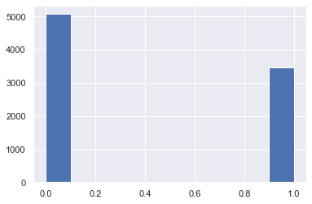
Dataset Modelling
Taken a sample dataset from “AliveCor's Short Single Lead ECG Recording” dataset (short 2000ms ECG Amplitude data)
Skewness check was done by plotting histogram on counts of occurrence of 0 (58%) and 1
Shuffled the dataset and divided it into training and validation testing.
Time Signals | 0 | 1 | 2 | 3 | 4 | 5 | 6 … | 1999 | Label
Row 1 | 0.035032 | 0.037155 | 0.044586 | 0.063694 | 0.076433 | 0.085987 | 0.089172 | -0.02229 | Normal
Row 2 | -0.03529 | -0.03257 | -0.03094 | -0.02986 | -0.03149 | -0.0342 | -0.03746 | 0.001086 | Normal
Row 3 | -0.30392 | -0.26144 | -0.22222 | -0.19281 | -0.17647 | -0.1634 | -0.14706 | -0.06536 | Normal
Row 4 | 0.109467 | 0.117604 | 0.128698 | 0.142012 | 0.153107 | 0.161982 | 0.170118 | 0.013314 | Abnormal
Row 5 .. | -0.01986 | -0.01715 | -0.01444 | -0.01173 | -0.00993 | -0.00812 | -0.00632 | 0 | Abnormal
Row 853 | -0.02503 | -0.02503 | -0.02253 | -0.01877 | -0.01126 | 0.001252 | 0.017522 | -0.0776 | Abnormal
Figure 7 Histogram Normal and Abnormal ECG Occurrence; Description: This figure shows the histogram of count of the Normal(0), and Abnormal(1) occurrence in the ECG database
Table 1 Sample ECG Alivecor short single lead dataset

Slide 12
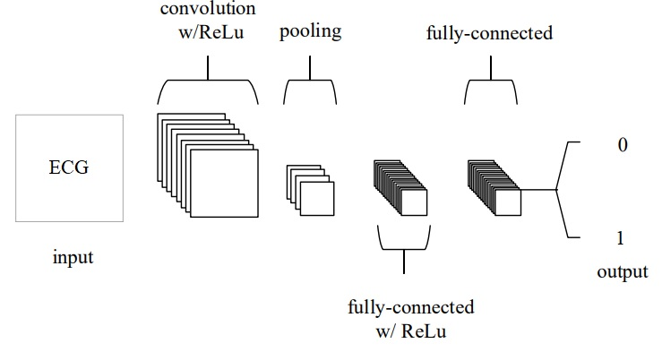
Dataset Modelling
There is no correlation between any two columns as max value of correlation matrix is 0.01667 i.e 1.667%.
Features are time valued columns with equal weights and “Label” column as predicting column.
Each row seems as an image matrix so this seemed as an image classification problem.
CNN model works better in a sharp object and edge detections techniques.
Input layer shape (2000x1), 8 hidden layers (ReLu), flattened output layer (linear), performed max pooling, dropouts and then dense layer is created.
Max pooling is used to get maximum value in each patch of feature map, highlights most abundant feature in patch.
Utilized Adam Optimizer with learning rate of 0.00006, with total of 100 epochs, batch size of 128 and validation split of 0.2
Single Row ECG Plot
Figure 9 Convolution Neural Network

Slide 13
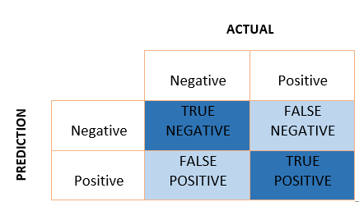
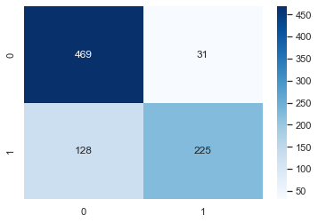

Results and Discussion
To better represent normal and abnormal ECGs, we renamed the designated column 0 and 1
A Convolution Neural Network (CNN) model was tested with 100 epochs and 128 batch size.
After evaluation we received an 81.36 % accuracy and loss about 28.8%
Constructed the confusion matrix and estimated the precision, recall, and F1 score .
$Precision= \frac{TP}{TP+FP}$ ; $Recall= \frac{TP}{TP+FN}$ ; $F1 score= \frac{2∗(Precision∗Recall)}{(Precision+Recall)}$
 | Precision | Recall | F1 score
Normal | 0.79 | 0.94 | 0.86
Atrial Fibrillation | 0.88 | 0.64 | 0.74
Confusion Matrix
Table 2 Precision, Recall, F1 score

Slide 14
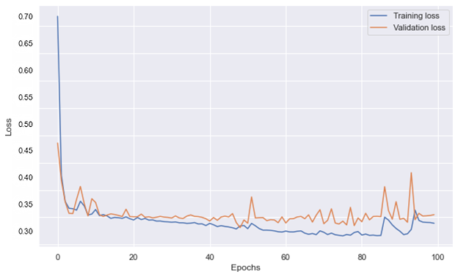
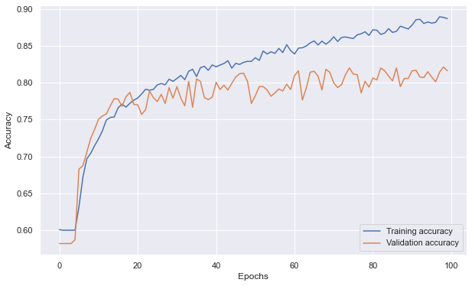
Results and Discussion
Loss v/s Epochs for Training Loss and Validation Loss
Accuracy v/s Epochs for Training Accuracy and Validation Accuracy

Slide 15
Results and Discussion
The circuit diagram setup is done using the programmable chip Teensy 3.2, Bluetooth module, and the LCD device.
The teensyduino and Arduino programming IDE are used to compile and execute the code.
We were stuck at a Teensy 3.2 is out of stock everywhere, so we ordered a higher version, i.e., Teensy 4.0, to set up the circuit, but Teensy 4.0 lacked a hardware unit named “Programmable Delay Block” (PDB) which is used in reading low input signals and converting them from analog to digital. The setup and code were tried on Teensy 4.0, and input is taken using two steel plate electrodes. It was difficult to solder a steel plate.
Prediction can be easily tested on cloud just by sending data on
https://ecgbtp.herokuapp.com/?ecgData= BASE_64_ECG_DATA_2000MS
If for the setup teensy of any range from 3.0 of 3.6 is used we can achieve these expected results:
Live display of the ECG wave on LCD monitor
Trained model has been uploaded on Heroku python for online testing of the recorded data that is sent online
The fetched results can be directly displayed on the LCD as abnormal or normal with percentage of accuracy.
Along with the predicted data there should be a exported datasheet of ECG in form of pdf for a doctor review.
Live serial data recording on a user can be done in a handy situation

Slide 16
Conclusion
Learned how our hearts operate and how an ECG works, and risk factors can detected using an ECG.
Analyzed products available in market, and need of making move from traditional to cheap portable devices.
Studied parts of ECG waves and different sections like P-wave, QRS-complex, T-wave, etc.
Studied how a 1D convolutional neural network model can be built and how it can be used to effectively predict Atrial Fibrillation.
Measure of accuracy, precision and recall of our model and got accuracy of about 81.36% and loss of about 28.8%
We implemented the circuit design and built a basic device, we faced error while soldering the steel plate and problem related to higher version of teensy programmable chip which lacked Programmable Delay Box hardware unit leading to issue on using libraries related to ADC conversion and small input reads.
Learnt about micropattern electrodes, which can be used to improve the accuracy, grip and precision.

Slide 17

Future Scopes
Following that, we can proceed to improve device configuration, implementation, and data collection.
Eventually, we can get a marketable and portable, non-invasive point-of-care ECG device that will record electrocardiograms and other vital signs.
More work can be done on the machine learning model to make it more efficient and can be trained on the bigger dataset.
This setup can be assembled into a small PCB board making it a portable ECG device .
This device can be enhanced for detecting further abnormalities in the ECG.
This can also be used as a addon to other complex device making a easy full body checkup if collaborated with heath startups
Figure 11 Prototype of ECG portable device; Description: This 3D object shows a prototype design of a portable ECG device that can be developed using a PCB board chip

Slide 18
References
An, X., & Stylios, G. (2018). A Hybrid Textile Electrode for Electrocardiogram (ECG) Measurement and Motion Tracking. Materials, 11(10), 1887. https://doi.org/10.3390/ma11101887
Camm, A. J., Lüscher, T. F., Maurer, G., & Serruys, P. W. (Reds.). (2018). ESC CardioMed. ESC CardioMed. https://doi.org/10.1093/med/9780198784906.001.0001
Gargiulo, G. D. (2015). True Unipolar ECG Machine for Wilson Central Terminal Measurements. BioMed Research International, 2015, 1–7. https://doi.org/10.1155/2015/586397
H. Karam, E., Tashan, T., & F. Mohsin, E. (2019). Design of Model Free Sliding Mode Controller based on BBO Algorithm for Heart Rate Pacemaker. International Journal of Modern Education and Computer Science, 11(3), 31–37. https://doi.org/10.5815/ijmecs.2019.03.05
Haider, A., & Fazel-Rezai, R. (2014). Heart Signal Abnormality Detection Using Artificial Neural Networks1. Journal of Medical Devices, 8(2). https://doi.org/10.1115/1.4027015
Hong, S., Zhang, W., Sun, C., Zhou, Y., & Li, H. (2022). Practical Lessons on 12-Lead ECG Classification: Meta-Analysis of Methods From PhysioNet/Computing in Cardiology Challenge 2020. Frontiers in Physiology, 12. https://doi.org/10.3389/fphys.2021.811661
Husain, K., Mohd Zahid, M. S., Ul Hassan, S., Hasbullah, S., & Mandala, S. (2021). Advances of ECG Sensors from Hardware, Software and Format Interoperability Perspectives. Electronics, 10(2), 105. https://doi.org/10.3390/electronics10020105

